Slide 1

STAR PLUS movie production project analysis :
GROUP NAME:MAC J SERIES CREW

Slide 2
GROUP MEMBERS 1. Joel Ngugi 2. Timothy Zulu 3. Oscar KLUGER 4. Mohammed 5MiSylvestachael Graham

Slide 3

BUSINESS OVERVIEW
Microsoft’s Entry into the Movie Industry

Slide 4
OBJECTIVES
Microsoft aims to establish a new movie studio to capitalize on the growing trend of original video content created by major corporations. The goal is to identify successful film genres and trends in the current box office landscape to guide the studio’s film production strategy.

Slide 5
INDUSTRY CONTEXT
The film industry is experiencing a significant shift with major tech companies like Amazon, Apple, and Netflix investing heavily in original content. The most successful films often exhibit trends that align with evolving consumer preferences, which include high-quality storytelling, innovative formats, and genre-specific appeal.

Slide 6
Market Analysis
Box Office Trends:
Top-Grossing Genres: Action, adventure, science fiction, and superhero films dominate the top box office charts. These genres typically feature high production values, engaging special effects, and broad audience appeal.
Emerging Trends: There is a growing interest in franchise films, nostalgic reboots, and high-concept dramas. Additionally, films with strong social themes or those that incorporate diverse storytelling perspectives are gaining traction.
Consumer Preferences:
High Production Value: Audiences are drawn to films with exceptional visual effects, sound design, and overall production quality.
Star Power: A-list actors and directors often contribute to a film's success, leveraging their existing fan base.
Original Content: Innovative storytelling and unique concepts tend to attract positive attention and generate buzz.
Competitive Landscape:
Established Studios: Major players like Disney, Warner Bros., and Universal have a strong foothold in successful film franchises and extensive distribution networks.
Streaming Platforms: Platforms like Netflix and Amazon Prime have shifted the focus to original content, with successful releases across various genres and formats.

Slide 7





Analysis Tools
For our analysis we used
Libraries such as : a) b)
Analysis used :
Visualizations used :

Slide 8
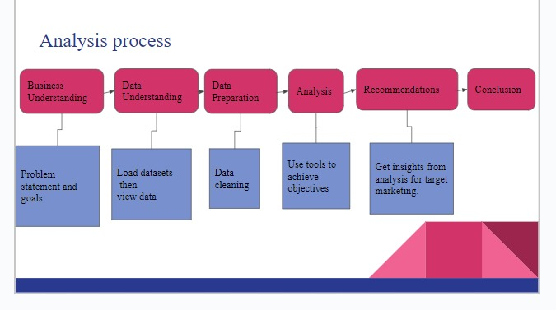
Analysis process conducted

Slide 9
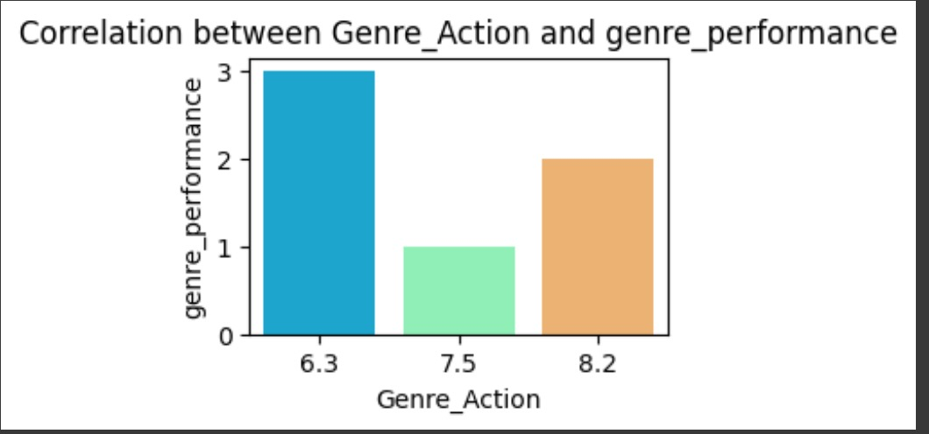
Data Visualization Visualizing through a bar graph

Slide 10
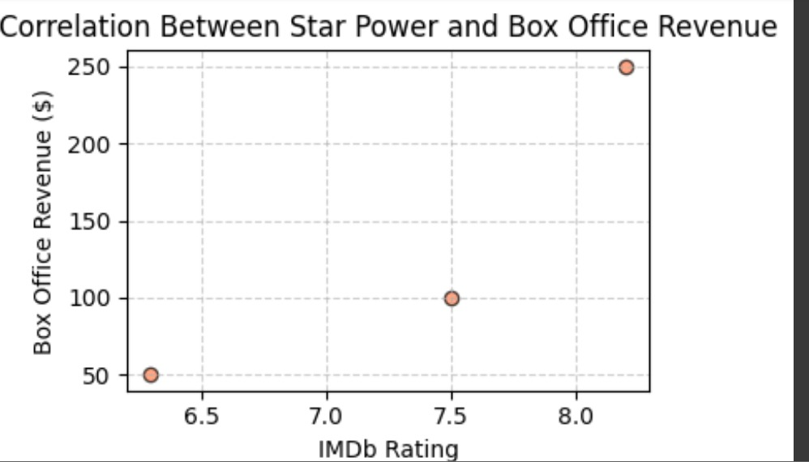
Visualizing on a scatter plot

Slide 11
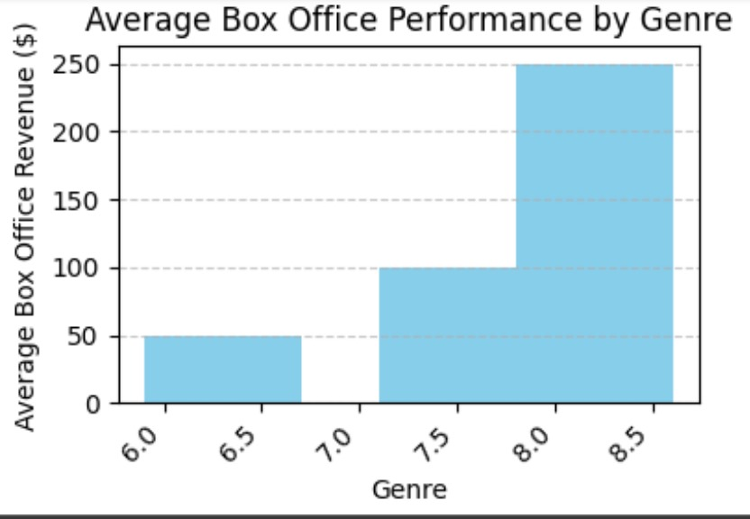
Visualizing on a bar graph

Slide 12
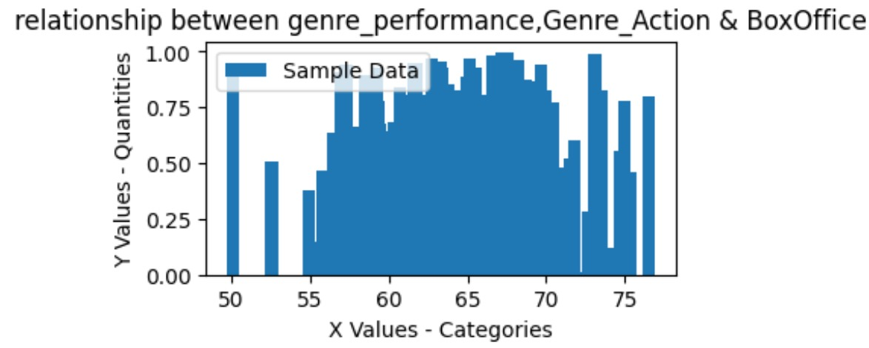
Visualizing on a vertical bar graph

Slide 13
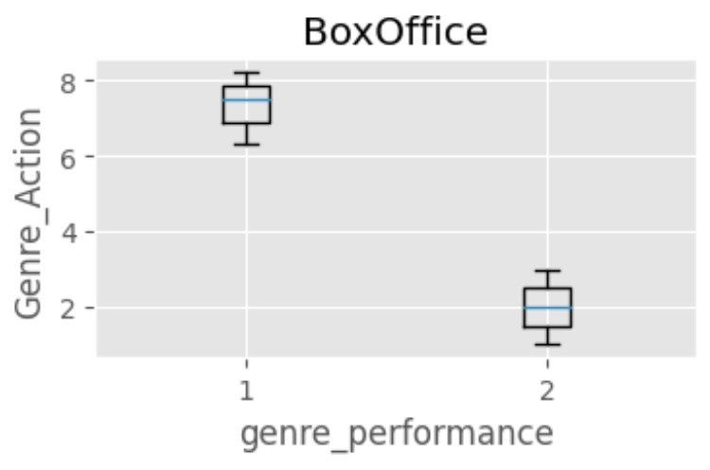
Visualizing on a Box Plot

Slide 14
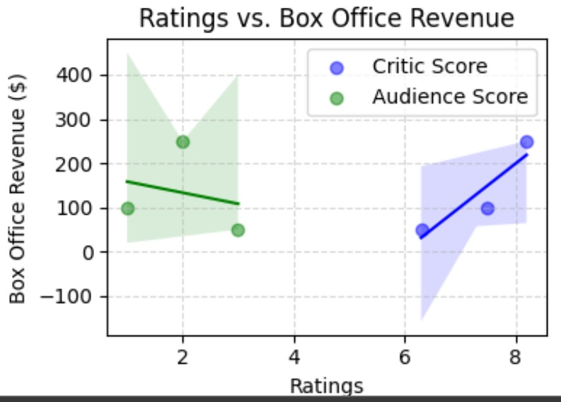
Visualizing through a seaborn

Slide 15
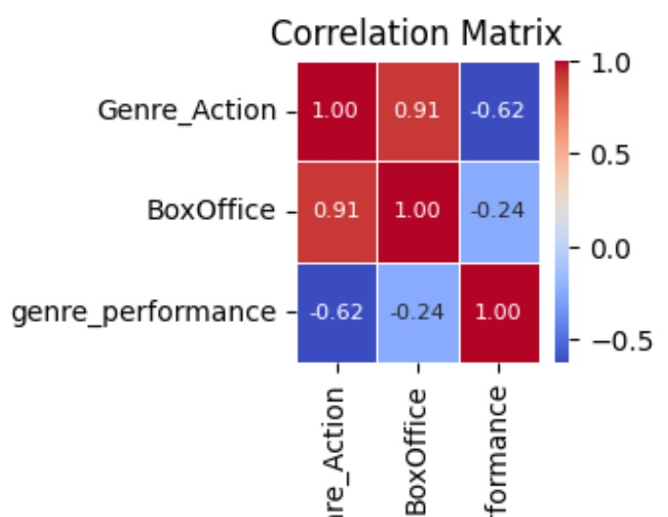
Visualizing through a Correlation Matrix

Slide 16
Research Findings
a. Box Office Trends
Top Genres: Identify which genres are performing best. For example, you might find that superhero films or animated features are leading.
Successful Elements: Discuss common features of successful films, such as high-profile actors, directors, or specific themes.
b. Demographic Insights
Audience Preferences: Highlight the demographics that are driving box office success. For example, younger audiences might prefer action-packed films, while older audiences might favor dramas.
c. Revenue Patterns
Seasonal Trends: Note any patterns related to the timing of film releases. For instance, summer blockbusters or holiday releases might have higher revenue.
Budget Analysis: Discuss how production budgets correlate with box office success.

Slide 17
Recommendations
Invest in Superhero and Animated Films: These genres are leading at the box office and have broad appeal.
Target Younger Audiences: Create content that resonates with younger viewers, incorporating diverse and contemporary themes.
Leverage High-Profile Talent: Utilize well-known actors and directors to attract audiences and boost marketing efforts.
Implement Innovative Marketing: Use engaging social media campaigns and strategic release timing to maximize visibility and ticket sales.
Monitor and Adapt: Use data analytics to continually refine strategies based on audience preferences and market trends.

Slide 18
Conclusion
In conclusion, to ensure success for Microsoft’s new movie studio, focus on producing high-demand superhero and animated films, targeting younger audiences with diverse and engaging content, leveraging high-profile talent, and employing innovative marketing strategies. Continuously adapt based on data-driven insights to stay aligned with market trends and maximize impact.

